Slide 1
WebScript Technologies
A Project On
CABLE OPERATOR MANAGEMENT SYSTEM

Slide 2
Company Profile:
WebScript Technologies is a Pune based software company established in Feb 2012. They are working on different platforms including desktop application, web based application, mobile application, microcontroller based application etc. WebScript Technologies team is continuously taking effort to study and analyze latest technologies and adopt them as per requirement in different vertical and horizontal solutions.
An ERP(Enterprise Resource Planning)solution aims to provide single software which will integrate all the divisions in your organization planning, manufacturing, sales, marketing, finance, HR and yet fulfill each division’s information and planning needs.
By adopting new standards and a relentless pursuit of continuous improvement in their quality management systems and processes, they continue to ensure commitment to customer satisfaction.

Slide 3
Introduction:
Cable Operator Management System is integrated and automation software for cable operators. Cable operators will distribute TV channels to their customers for that they charge some money monthly.
To maintain their customers and number of users this software provides automation. In this COM System they can main their staff member’s details and their customer details. By using this COM System they can divide their areas macro parts to micro parts. By using this system they can meet their business requirements. Cable Operators once they divided their areas into micro parts then they can assign their staff members to take care about their micro part areas.
The updates are infrequent and may be regarded as permanently stored in the Database. The Master Group has functionality to Change. The master pages will have access to administrators only.

Slide 4
Scope :
To maintain entire operations of the cable operator to be Automated.
Tools and Technology used:
OPERATING SYSTEM : WINDOWS
FRONT END : HTML,CSS,JQUERY
BUSINESS LOGIC : PHP
DATABASE : MYSQL

Slide 5
Roles and Responsibilities :
We gather the requirements from the client, which act as inputs for the development of the application. To gather requirements from different types of clients, we follow different techniques like personal interviews, questioners, observation, record review etc., for a web-base application there is requirement to understanding a problem.
Different designing phases for easy to use by customer.
Getting details from administrator, customer view shows the shows details according to client requirement.
For area wise collection, particular employee have all the details of their area customer and give it to administrator to generate report for make easy to all operations of cable operators accurate.
Access control for data which require user authentication uses registered mobile number and password. For the access control use this mobile number and password for customer and employee login.
Shows all the details of package like active plan, plan history, active date of package and also profile of customer or employee etc.

Slide 6
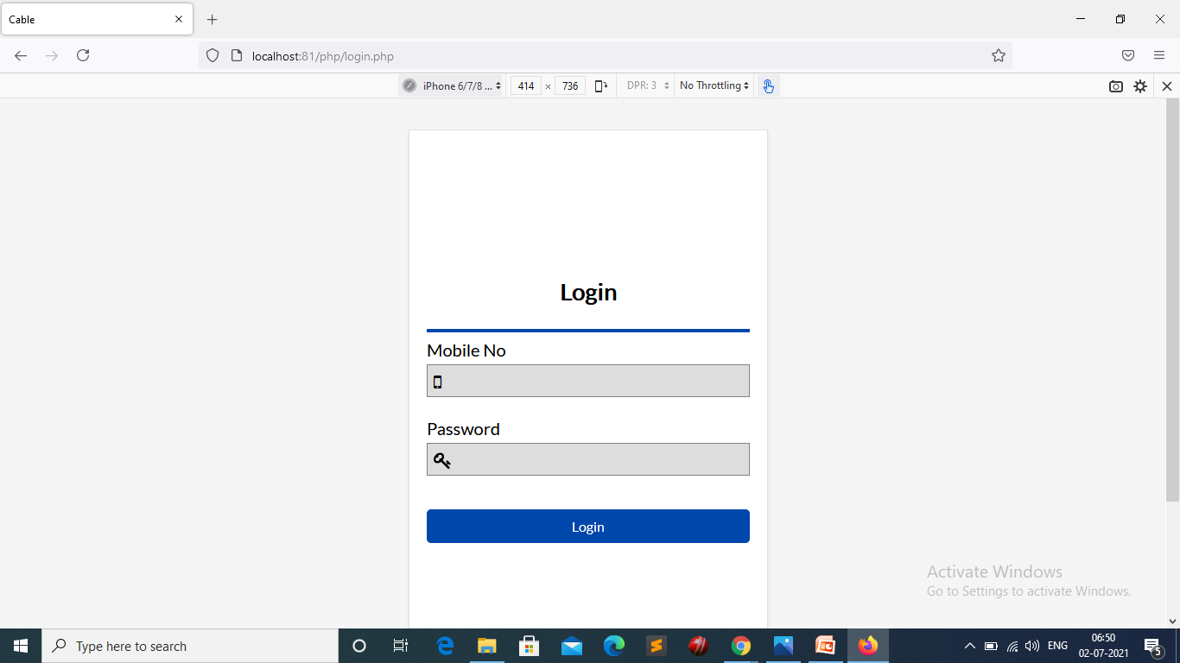

Slide 7


Slide 8
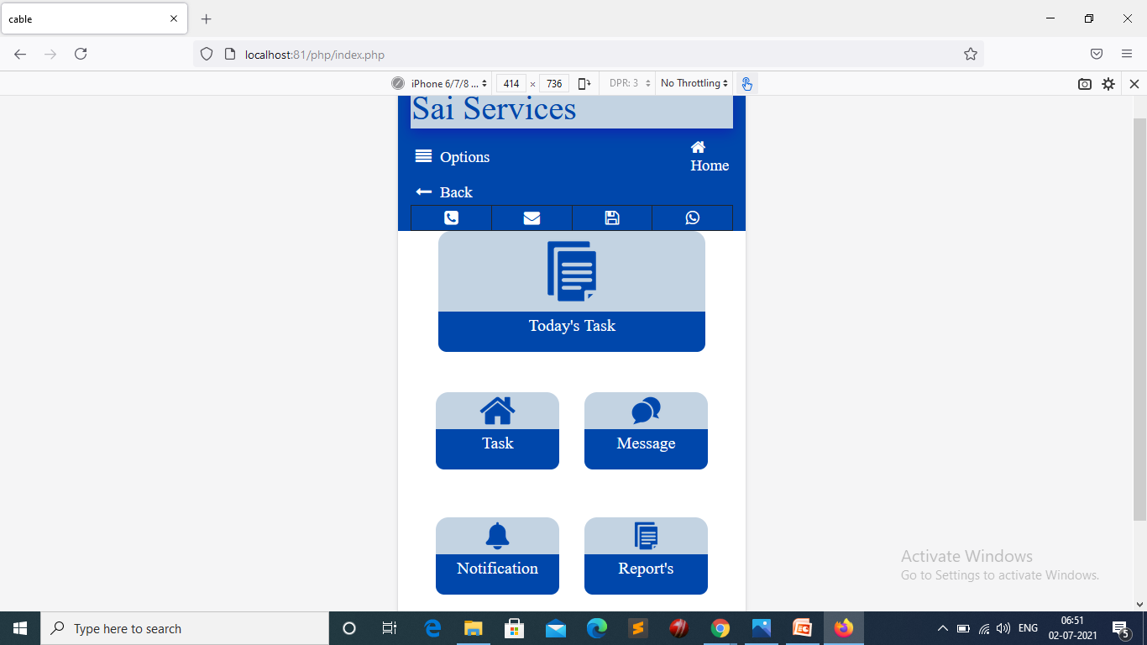

Slide 9
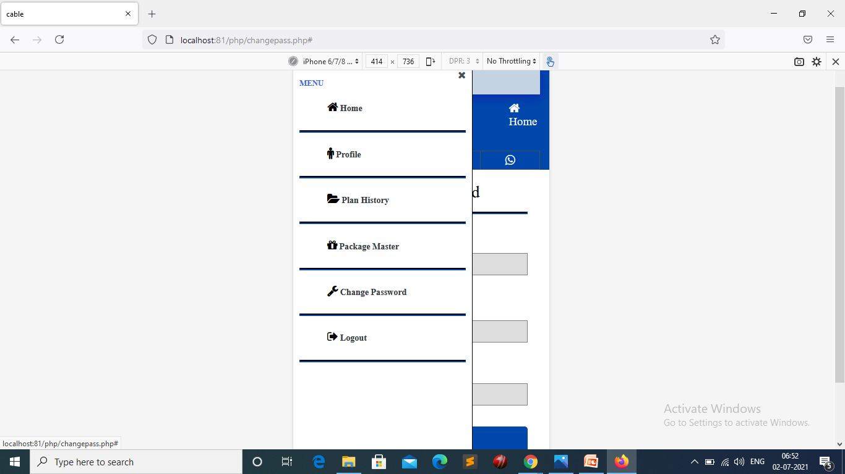

Slide 10
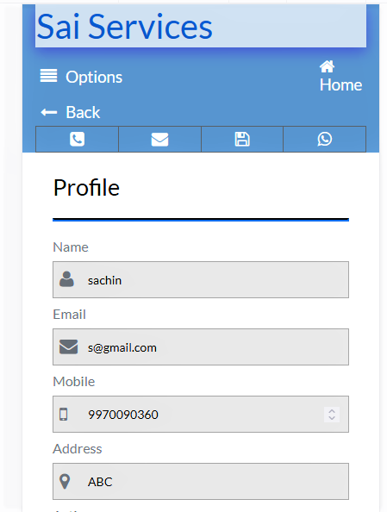
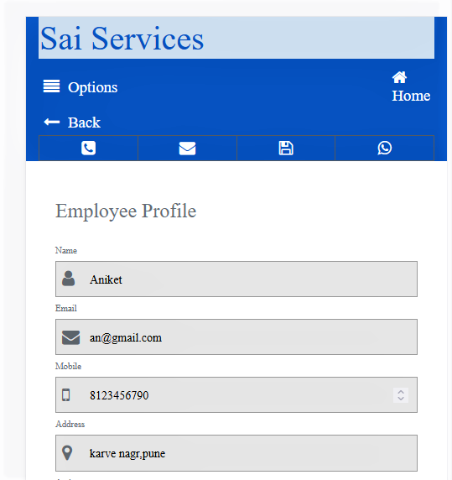

Slide 11
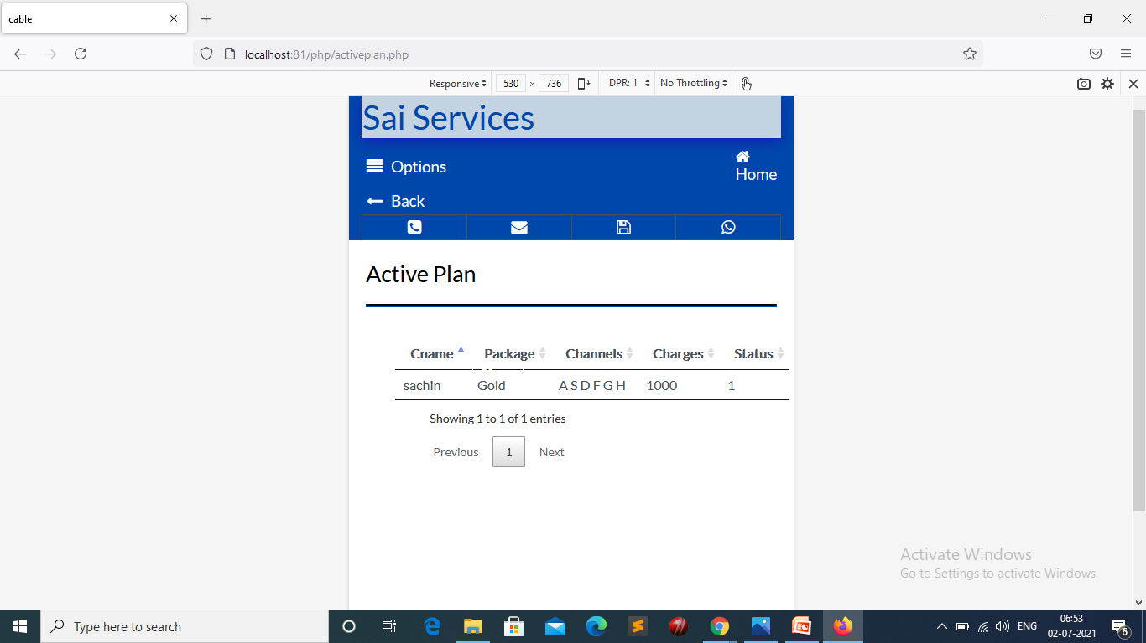

Slide 12
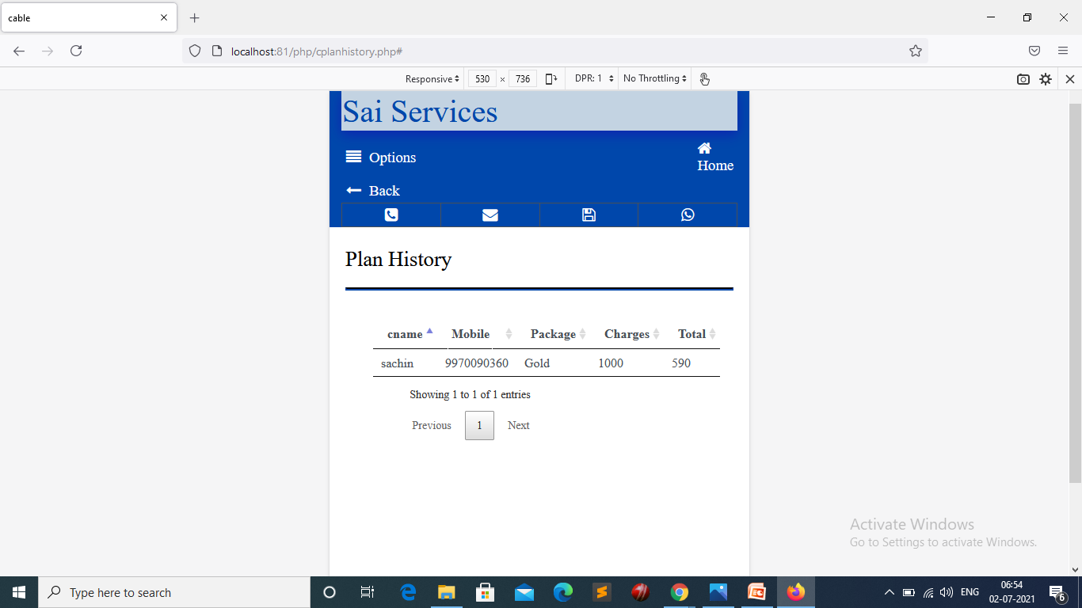

Slide 13
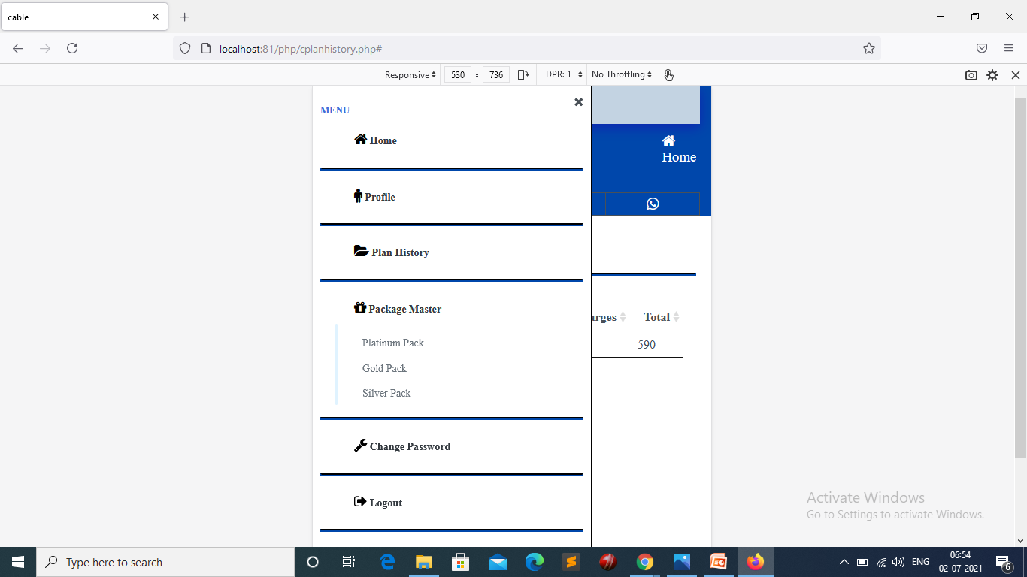

Slide 14
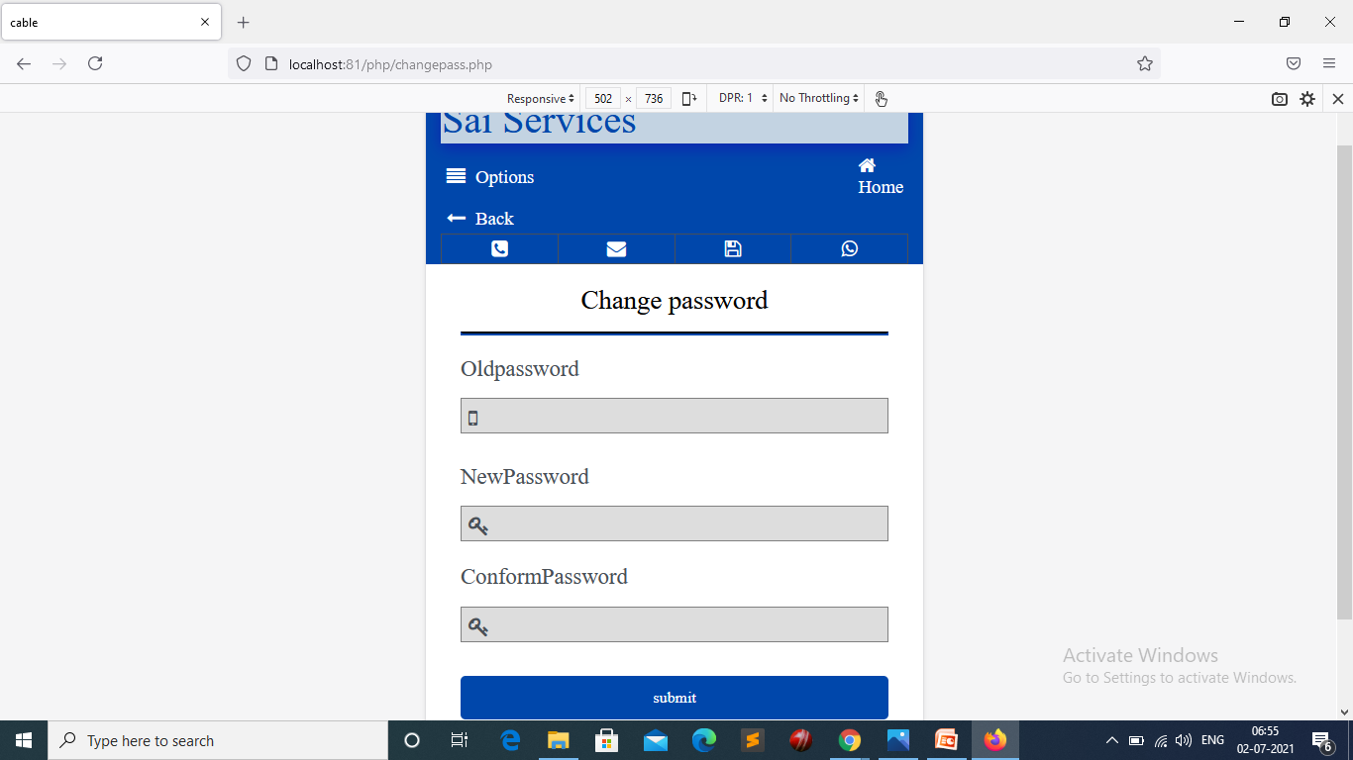

Slide 15
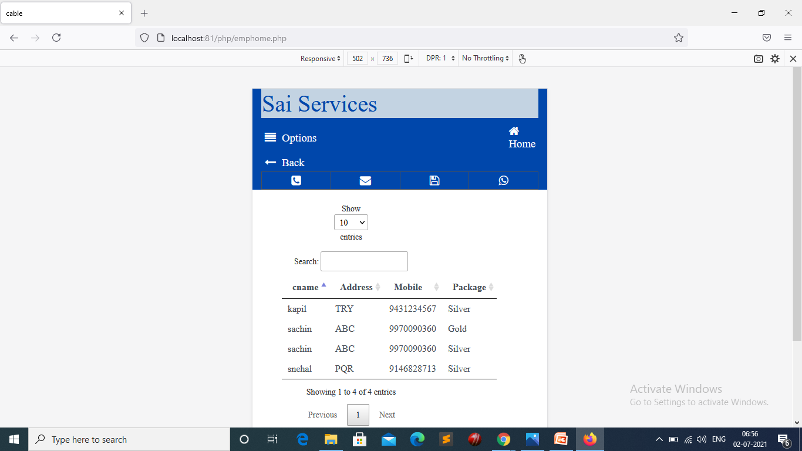

Slide 16
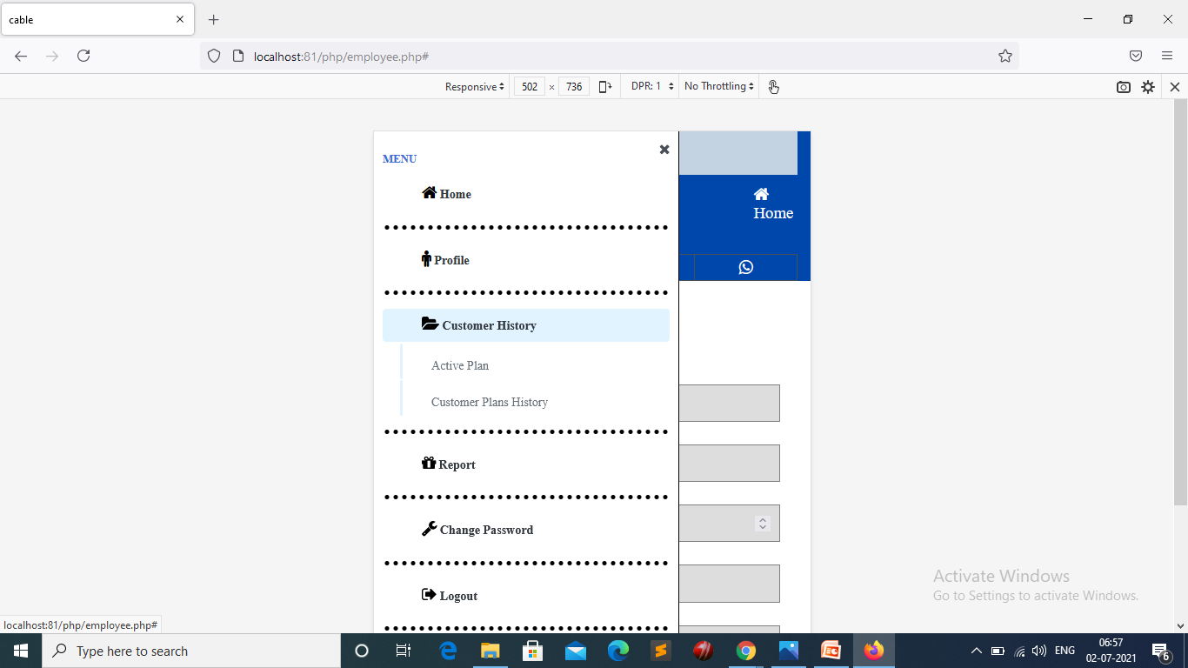

Slide 17
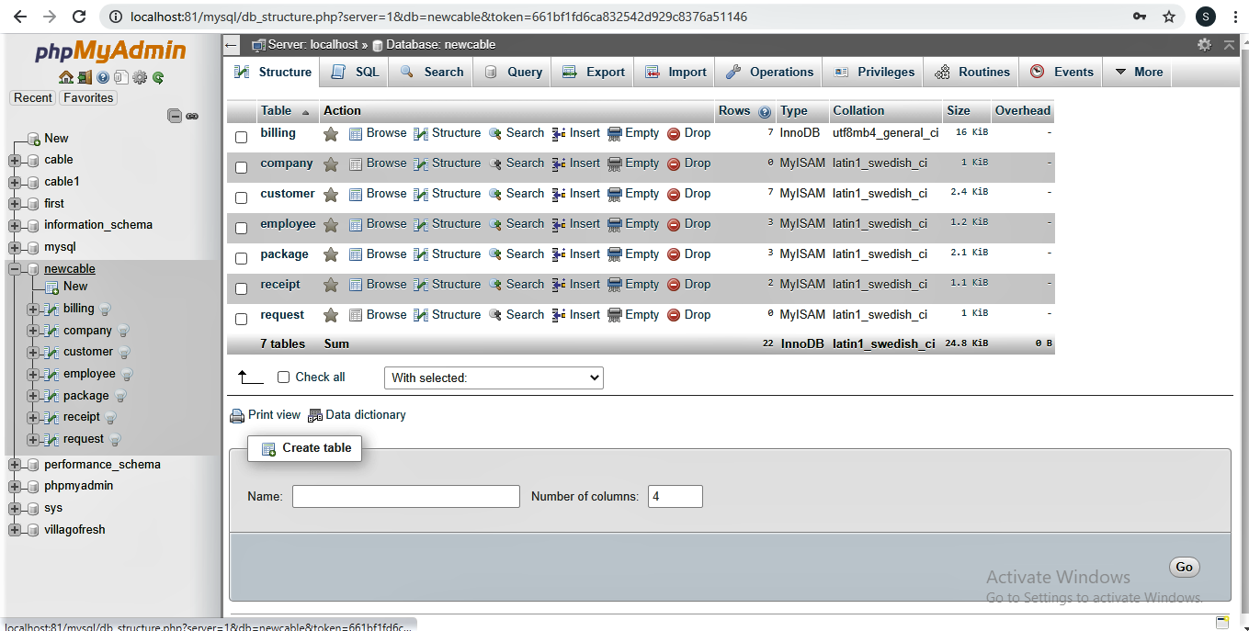

Slide 18
Thank you

